Slide 1




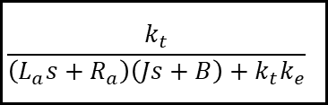
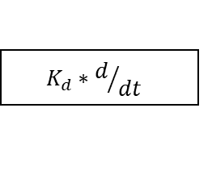


$$K_{P}$$
SP
err
+
CO
Y
+
$$\frac{k_{t}}{\left(L_{a}s+R_{a}\right)\left(Js+B\right)+k_{t}k_{e}}$$
$$K_{I}∗\int{dt}$$
-
+
FB
传递函数
$$K_{d}∗d/{dt}$$
系统结构图化简
${L_{a}\frac{di_{a}}{dt}+R_{a}i}_{a}=u_{a}$- $K_{e}ω$
$$\left(L_{a}s+R_{a}\right)I_{a}\left(s\right)=U_{a}\left(s\right)−K_{e}ω\left(s\right)$$
$J\frac{dω}{dt}+Bω =k_{t}∙i_{a}$- $T_{L}$
$$\left(Js+B\right)ω\left(s\right)=K_{t}I_{a}\left(s\right)−T_{L}$$

Slide 2


















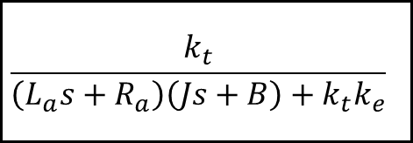

$$\left(L_{a}s+R_{a}\right)I_{a}\left(s\right)=U_{a}\left(s\right)−K_{e}ω\left(s\right)$$
$$\frac{k_{t}}{\left(L_{a}s+R_{a}\right)\left(Js+B\right)+k_{t}k_{e}}$$
$$u_{a}$$
$$ω$$
$$\left(Js+B\right)ω\left(s\right)=K_{t}I_{a}\left(s\right)−T_{L}$$
$$T_{L}$$
$$U_{a}$$
$$I_{a}$$
$$T_{m}$$
-
$$ω$$
$\frac{1}{L_{a}s+R_{a}}$
$K_{t}$
$\frac{1}{Js+B}$
-
$K_{e}$

Slide 3







$$x$$
$G\left(s\right)$
$$y$$
1. 环节
2. 信号
$$x$$
3. 比较点
4. 引出点

Slide 4



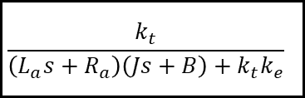

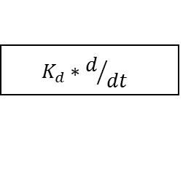




$$K_{P}$$
SP
err
+
CO
Y
$$\frac{K_{I}}{s}$$
+
$$\frac{k_{t}}{\left(L_{a}s+R_{a}\right)\left(Js+B\right)+k_{t}k_{e}}$$
$$K_{I}∗\int{dt}$$
-
+
FB
$$K_{d}∗d/{dt}$$
$$K_{D}s$$
$$x$$
$G\left(s\right)$
$$y$$
$$x$$
1. 环节
2. 信号
3. 比较点
4. 引出点

Slide 5












$$\left(L_{a}s+R_{a}\right)I_{a}\left(s\right)=U_{a}\left(s\right)−K_{e}ω\left(s\right)$$
$$\left(Js+B\right)ω\left(s\right)=K_{t}I_{a}\left(s\right)−T_{L}$$
$$T_{L}$$
$$U_{a}$$
$$I_{a}$$
$$T_{m}$$
-
$$ω$$
$\frac{1}{L_{a}s+R_{a}}$
$K_{t}$
$\frac{1}{Js+B}$
-
$K_{e}$

Slide 6




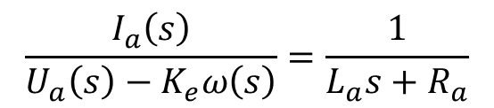


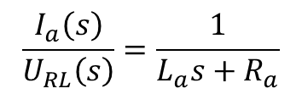

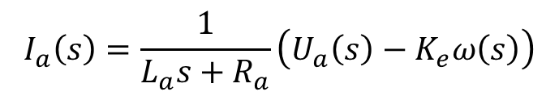


$$\left(L_{a}s+R_{a}\right)I_{a}\left(s\right)=U_{a}\left(s\right)−K_{e}ω\left(s\right)$$
Ra
La
$$I_{a}\left(s\right)=\frac{1}{L_{a}s+R_{a}}\left(U_{a}\left(s\right)−K_{e}ω\left(s\right)\right)$$
Ua(t)
ia(t)
e(t)=keω(t)
$$\frac{I_{a}\left(s\right)}{U_{a}\left(s\right)−K_{e}ω\left(s\right)}=\frac{1}{L_{a}s+R_{a}}$$
设中间变量$U_{RL}\left(s\right)=U_{a}\left(s\right)−K_{e}ω\left(s\right)$，那么：
$$U_{a}$$
$$U_{RL}$$
$$I_{a}$$
$\frac{1}{L_{a}+R_{a}}$
$$U_{RL}\left(s\right)= U_{a}\left(s\right)−K_{e}ω\left(s\right)$$
-
$K_{e}$
$$ω$$
$$\frac{I_{a}\left(s\right)}{U_{RL}\left(s\right)}=\frac{1}{L_{a}s+R_{a}}$$

Slide 7



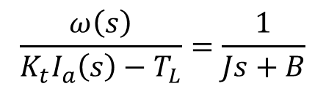



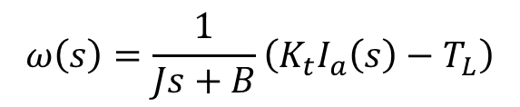

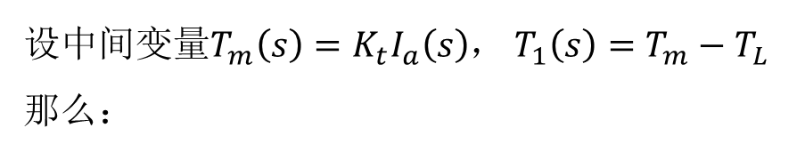


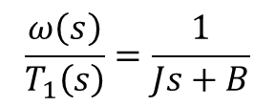



$$\left(Js+B\right)ω\left(s\right)=K_{t}I_{a}\left(s\right)−T_{L}$$
$$T_{m}=k_{t}∗i_{a}$$
$$Bω$$
$$T_{L}$$
$$ω\left(s\right)=\frac{1}{Js+B}\left(K_{t}I_{a}\left(s\right)−T_{L}\right)$$
$$J$$
$$\frac{ω\left(s\right)}{K_{t}I_{a}\left(s\right)−T_{L}}=\frac{1}{Js+B}$$
设中间变量$T_{m}\left(s\right)=K_{t}I_{a}\left(s\right)$， $T_{1}\left(s\right)=T_{m}−T_{L}$那么：
$$T_{L}$$
-
$$T_{1}$$
$$I_{a}$$
$K_{t}$
$$T_{m}$$
$\frac{1}{Js+B}$
$$ω$$
$$\frac{ω\left(s\right)}{T_{1}\left(s\right)}=\frac{1}{Js+B}$$

Slide 8














$$\left(L_{a}s+R_{a}\right)I_{a}\left(s\right)=U_{a}\left(s\right)−K_{e}ω\left(s\right)$$
$$\left(Js+B\right)ω\left(s\right)=K_{t}I_{a}\left(s\right)−T_{L}$$
$$T_{L}$$
$$U_{a}$$
$$U_{RL}$$
-
$$T_{1}$$
$$I_{a}$$
$$I_{a}$$
$K_{e}$
$$T_{m}$$
$\frac{1}{Js+B}$
$$ω$$
$\frac{1}{L_{a}+R_{a}}$
-
$K_{e}$
$$ω$$

Slide 9







$$T_{L}$$
$$U_{a}$$
$$I_{a}$$
$$T_{m}$$
-
$$ω$$
$\frac{1}{L_{a}s+R_{a}}$
$K_{t}$
$\frac{1}{Js+B}$
-
$K_{e}$

Slide 10










1. 串联
$$G_{1}\left(s\right)$$
$$G_{2}\left(s\right)$$
$$G_{1}\left(s\right)G_{2}\left(s\right)$$
$$G_{1}\left(s\right)$$
2. 并联
$$G_{1}\left(s\right)+G_{2}\left(s\right)$$
$$G_{2}\left(s\right)$$
$$G_{1}\left(s\right)$$
3. 反馈
-
$\frac{G_{1}\left(s\right)}{1+G_{1}\left(s\right)G_{2}\left(s\right)}$
$$G_{2}\left(s\right)$$
4. 分离点前（后）移
5. 比较点前（后）移

Slide 11




$$G_{1}\left(s\right)$$
$$G_{2}\left(s\right)$$
$$G_{1}\left(s\right)G_{2}\left(s\right)$$

Slide 12



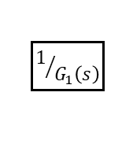

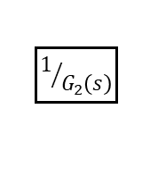










4. 分离点前（后）移
$$G_{1}\left(s\right)$$
$$G_{2}\left(s\right)$$
$$G_{1}\left(s\right)$$
$$G_{2}\left(s\right)$$
$$G_{1}\left(s\right)$$
$$G_{1}\left(s\right)$$
$$G_{2}\left(s\right)$$
$$1/{G_{2}\left(s\right)}$$
$$1/{G_{1}\left(s\right)}$$
5. 比较点前（后）移
$$G_{1}\left(s\right)$$
$$G_{2}\left(s\right)$$
$$G_{1}\left(s\right)$$
$$G_{2}\left(s\right)$$
$$G_{1}\left(s\right)$$
$$G_{1}\left(s\right)$$
$$G_{2}\left(s\right)$$

Slide 13





















$$T_{L}$$
$$U_{a}$$
$$I_{a}$$
$$T_{m}$$
-
$$ω$$
$\frac{1}{L_{a}s+R_{a}}$
$K_{t}$
$\frac{1}{Js+B}$
-
$K_{e}$
$$U_{a}$$
$$I_{a}$$
$$T_{m}$$
$$ω$$
$\frac{1}{L_{a}s+R_{a}}$
$K_{t}$
$\frac{1}{Js+B}$
-
$K_{e}$

Slide 14












$$U_{a}$$
$$I_{a}$$
$$T_{m}$$
$$ω$$
$\frac{1}{L_{a}s+R_{a}}$
$K_{t}$
$\frac{1}{Js+B}$
-
$K_{e}$
$$U_{a}$$
$$ω$$
$\frac{K_{t}}{\left(L_{a}s+R_{a}\right)\left(Js+B\right)}$
-
$K_{e}$

Slide 15




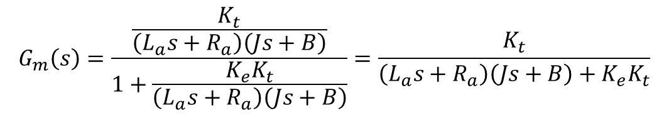








$$U_{a}$$
$$ω$$
$\frac{K_{t}}{\left(L_{a}s+R_{a}\right)\left(Js+B\right)}$
$$G_{1}\left(s\right)$$
-
$\frac{G_{1}\left(s\right)}{1+G_{1}\left(s\right)G_{2}\left(s\right)}$
-
$$G_{2}\left(s\right)$$
$K_{e}$
$$G_{m}\left(s\right)=\frac{\frac{K_{t}}{\left(L_{a}s+R_{a}\right)\left(Js+B\right)}}{1+\frac{K_{e}K_{t}}{\left(L_{a}s+R_{a}\right)\left(Js+B\right)}}=\frac{K_{t}}{\left(L_{a}s+R_{a}\right)\left(Js+B\right)+K_{e}K_{t}}$$

